Slide 1

Cigna Benefits

Slide 2

OAP Plan Highlights
Benefits | In-Network |  | Out-of-Network
Deductible | $500 Employee $1,000 Family |  | $750 Employee $1,500 Family
Out of Pocket Maximum | $1,500 Employee $3,000 Family |  | $2,500 Employee $5,000 Family
Preventive Care | No charge, No deductible |  | Plan pays 70%, after deductible
Office Visits | $25 PCP copay |  | Plan pays 70%, after deductible
 | $35 Specialist copay |  | Plan pays 70%, after deductible
Inpatient Services | Plan pays 100%, after deductible |  | Plan pays 70%, after deductible
Outpatient Services | Plan pays 100%, after deductible |  | Plan pays 70%, after deductible
Emergency Room | $200 copay per visit (copay waived if admitted)
Urgent Care | $40 copay per visit
Telehealth | $25 copay, and plan pays 100% | Not Covered
Lab and Radiology Services | Plan Pays 100%, after deductible | Plan pays 70%, after deductible
-Only the amount you pay for in-network covered expenses counts towards your in-network deductible. Only the amount you pay for out-of-network covered expenses counts towards your out-of-network deductible.
-Family members meet only their individual deductible and then their claims will be covered under the plan coinsurance. If the family deductible has been met prior to their individual deductible being met, their claims will be paid at the plan co-insurance.

Slide 3
OAPIN Plan Highlights
Benefits | In-Network
Deductible | $500 Employee $1,000 Family
Out of Pocket Maximum | $1,500 Employee $3,000 Family
Preventive Care | No charge, No deductible
Office Visits | $25 PCP copay $35 Specialist copay
Inpatient Services | Plan pays 100%, after deductible
Outpatient Services | Plan pays 100%, after deductible
Emergency Room | $200 copay per visit (copay waived if admitted)
Urgent Care | $40 copay per visit
Telehealth | $25 copay, and plan pays 100%
Lab and Radiology Services | Plan pays 100%, after deductible
Family members meet only their individual deductible and then their claims will be covered under the plan coinsurance. If the family deductible has been met prior to their individual deductible being met, their claims will be paid at the plan co-insurance.

Slide 4
HSA Plan Highlights
Benefits | In-Network | Out-of-Network
Employer Contribution | Employee: up to $500 Family: up to $1,000
Deductible | $1,600 Employee $3,200 Family | $1,600 Employee $3,200 Family
Out of Pocket Maximum | $3.000 Employee $6,000 Family | $3.000 Employee $6,000 Family
Preventive Care | No charge, No deductible | Plan pays 80%, after deductible
Office Visits – Primary & Specialist | Plan pays 100%, after deductible | Plan pays 80%, after deductible
 |  | Plan pays 80%, after deductible
Inpatient Services | Plan pays 100%, after deductible | Plan pays 80%, after deductible
Outpatient Services | Plan pays 100%, after deductible | Plan pays 80%, after deductible
Emergency Room | Plan pays 100%, after deductible
Urgent Care | Plan pays 100%, after deductible
Telehealth | Plan pays 100%, after deductible | Not Covered
Lab and Radiology Services | Plan pays 100%, after deductible | Plan pays 80%, after deductible
-All plan maximums and service-specific maximums cross-accumulate between in- and out-of-network unless noted in SPD.
-All family members contribute towards the family deductible. An individual cannot have claims covered under the plan’s coinsurance until the total family deductible has been satisfied.

Slide 5
Pharmacy Benefits
 | OAP Plan | OAPIN Plan | HSA Plan
Retail 30-Day Supply | In-Network Only
Generic | You pay 20% (min. of $5/max. of $50) | You pay 20% (min. of $5/max. of $50) | After deductible, you pay 20% (min. of $5/max. of $50)
Preferred Brand | You pay 25% (min. of $15/max. of $50) | You pay 25% (min. of $15/max. of $50) | After deductible, you pay 25% (min. of $15/max. of $50)
Non-Preferred Brand | You pay 25% (min. of $20/max. of $50) | You pay 25% (min. of $20/max. of $50) | After deductible, you pay 25% (min. of $20/max. of $50)
Retail and Home Delivery 90-Day Supply | In-Network Only
Generic | You pay 20% (min. of $10/max. of $100) | You pay 20% (min. of $10/max. of $100) | After deductible, you pay 20% (min. of $10/max. of $100)
Preferred Brand | You pay 25% (min. of $30/max. of $100) | You pay 25% (min. of $30/max. of $100) | After deductible, you pay 25% (min. of $30/max. of $100)
Non-Preferred Brand | You pay 25% (min. of $40/max. of $100) | You pay 25% (min. of $40/max. of $100) | After deductible, you pay 25% (min. of $40/max. of $100)

Slide 6
Reminders:
Breast Ultrasound COVERAGE
Managing diabetes isn’t easy, but a new program that controls the cost of eligible insulin
As of 1/1/23, the OAP and OAPIN medical plans* now cover 1 dense breast tissue ultrasound per calendar year, covered at 100%, when performed by an in-network provider or facility; no plan deductible will apply.
All subsequent breast ultrasounds will be covered at standard plan rates.
*No change to the HSA plan coverage for breast ultrasound.
*No change to the Out-of-network plan coverage.
$25 max copay will apply to other drugs (beyond insulin) est. 7/1/2020
dependent on drug manufacturer participation

Slide 7
Patient Assurance Program
Cigna’s Patient Assurance Program helps lower your out-of-pocket medication costs. There’s nothing to join and no cost to participate – it’s part of your Cigna pharmacy benefit.
Managing diabetes isn’t easy, but a new program that controls the cost of eligible insulin products makes it more affordable. A 30-day (or one month) supply costs no more than $25, and a 90-day (or three month) supply costs no more than $75.
Eligible customers can use the program by showing their Cigna ID card at the pharmacy when they fill one of the covered insulin products. If you’re already using one of the covered insulins, there are no additional steps needed. You can take advantage of this program.
Basaglar, Humalog, Humulin, Levemir are example of covered medications. Additional insulin products may be included in the program. If you’re currently taking an insulin that is not included in the program, talk with your doctor about whether taking an insulin covered under the programis right for you.
$25 max copay will apply to other drugs (beyond insulin) est. 7/1/2020
dependent on drug manufacturer participation

Slide 8
Cigna Easy Choice Tool
  If you need help deciding which medical plan is best for you, the Cigna Easy Choice Tool may help you! The tool considers:
    Payroll contributions
    Out-of-pocket costs when you receive services
    Your basic information, for example, whether you will be covering dependents and your zip code.
    Log-in at https://decisionsupport.cigna.com and use access code ODES7H3D (ACA-eligible only, use code Z7FQPFXH).
    The Easy Choice decision support tool will provide you with plan choices, which you can compare and review.
Notes:
Do you need help deciding which plan is right for you? Use the Cigna Easy Choice Tool to help make your decision. The tool will factor your personal coverage information, along with what your payroll contributions and out-of-pocket costs when you receive services to help guide your choice.
Go to CignaEasyChoice.com and use Wesleyan’s access code DPZMPKK to log-in.

Slide 9
Cigna One Guide
  Contact a representative by calling the customer service number on the back of your Cigna insurance card or by going to myCigna.com.
    Answer coverage questions
    Keep on track with preventive visits
    Find the right health care providers in-network
    Connect to lifestyle management programs, clinical and behavioral health programs
    Get cost estimates and avoid surprise expenses
    Understand Explanation of Benefits (EOB) and medical bills
Notes:
Cigna OneGuide is accessed by the number on the back of your member card.

Slide 10

Virtual care¹
Cigna Healthcare has partnered with MDLIVE® to offer a comprehensive suite of convenient virtual care options — available by phone or video whenever it works for you.
Primary Care
Preventive care, routine care
and specialist referrals
  Preventive care checkups/ wellness screenings available at no additional cost²
  Prescriptions available through home delivery or at local pharmacies, if appropriate
  Receive orders for biometrics, blood work and screenings at local facilities³
Behavioral Care
Talk therapy and psychiatry
from the privacy of home
Access to psychiatrists and therapists
Schedule an appointment that works for you
Option to select the same provider for every session
Care for issues such as anxiety, stress, grief and depression
Urgent Care
On-demand care for minor medical conditions
On-demand 24/7/365, including holidays
Care for hundreds of minor medical conditions
A convenient and affordable alternative to urgent care centers and the ER
Prescriptions available, if appropriate
Dermatology⁴
Fast, customized care for skin, hair and nail conditions — no appointment required
Board-certified dermatologists review pictures and symptoms
Care for common skin, hair and nail conditions including acne, eczema, psoriasis, rosacea, suspicious spots and more
Diagnosis and customized treatment plan, usually within 24 hours
Notes:
KXC: https://cignaknowledge.lightning.force.com/lightning/r/Knowledge__kav/ka06Q000000N81jQAC/view
Video chat may not be available in all areas or with all providers so see your enrollment materials for details.

Slide 11

Virtual medical care¹
Cigna Healthcare has partnered with MDLIVE® to offer a comprehensive suite of convenient virtual care options — available by phone or video whenever it works for you. Conditions treated include:²
Acne
Allergies
Asthma
Bronchitis
Cold and flu
Constipation
Diarrhea
Earaches
Fever
Headaches
Insect bites
Joint aches
Nausea
Pink eye
Rashes
Respiratory and sinus infections
Sore throats
Urinary tract infections
Notes:
KXC: https://cignaknowledge.lightning.force.com/lightning/r/Knowledge__kav/ka06Q000000N81jQAC/view
Video chat may not be available in all areas or with all providers so see your enrollment materials for details.

Slide 12

Virtual behavioral care¹
Now you don't have to wait — or travel — for behavioral care. Cigna Healthcare has partnered with MDLIVE® so you can connect by video or phone to licensed therapists and psychiatrists, all from the privacy of home. Non-emergency behavioral/mental health conditions treated include:
Addiction
Bipolar disorder
Child/adolescent issues
Depression
Eating issues
Grief/loss
Life changes
Men’s issues
Postpartum depression
Panic disorders
Relationship and marriage issues
Stress
Parenting issues
Notes:
KXC: https://cignaknowledge.lightning.force.com/lightning/r/Knowledge__kav/ka06Q000000N81jQAC/view
Video chat may not be available in all areas or with all providers so see your enrollment materials for details.

Slide 13



Behavioral health: Supporting your needs
Network includes licensed therapists, psychiatrists and psychiatric nurse practitioners, behavioral facilities or programs and more
Fast access
First-time therapy within 5 business days
Prescriber appointments (psychiatrist
or psychiatric nurse practitioner) within 15 business days
Virtual care via online appointments with licensed counselors or psychiatrists¹

Slide 14



Behavioral health: Additional support
Seminars offered monthly on topics such as autism, eating disorders, substance use and behavioral health
Coaching/Support Services
Addresses challenges such as autism spectrum disorder, eating disorders,
pain management, substance use
Provides help for individuals and families when it comes to understanding a behavioral diagnosis or learning about treatment choices
Identifies in-network providers and
what you’ll pay
Online tools to locate in-network providers and facilities, as well
as stress management, health and well-being information

Slide 15
Cigna Total Behavioral Health® (CTBH)¹
myCigna.com® guided navigation
Our digital portal includes guided navigation that provides
you with customized, convenient care options (digital, coaching, virtual and in person).
Large, national network
Includes national virtual network that includes Talkspace, MDLIVE, Ginger, and more. Online scheduling and text messaging.
Fast Access network guarantees appointment scheduling in five business days.⁴ Appointment scheduling assistance provided.
Coaching & Support
Dedicated support for a broad range of conditions including
autism, eating disorders, intensive behavioral case management, substance use and opioid and pain management, and parents
and families.
24/7/365 crisis and emergency support
HappifyTM offered through Cigna
Increase resilience through games, guided meditations, and other activities. This digital self-guidance tool reduces stress while encouraging confidence³
iPrevail offered through Cigna
On-demand peer coaching and personalized learning to help
boost your mood and improve mental health care³

Slide 16
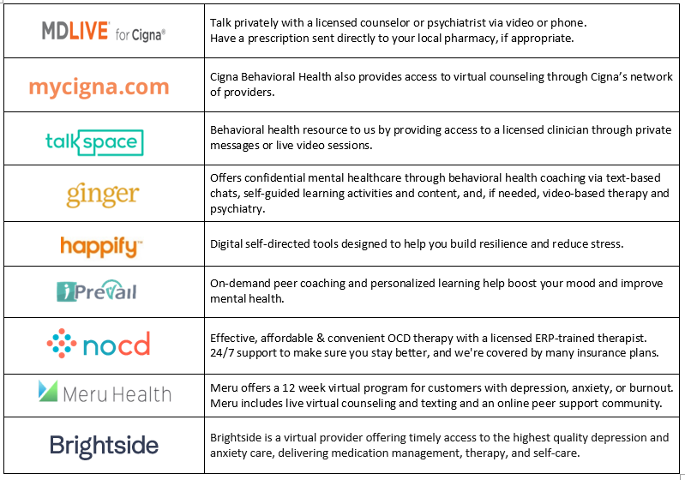
Behavioral Health Resources

Slide 17
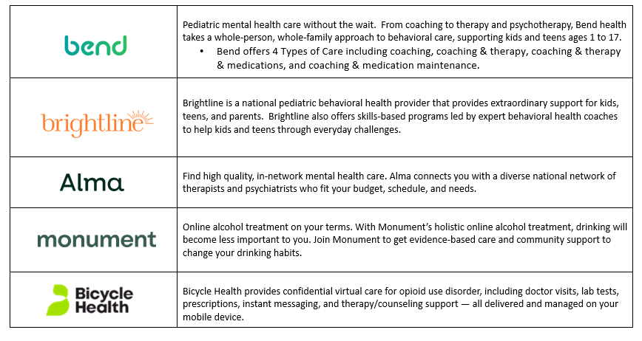
Behavioral Health Resources – Recently Added Digital Providers

Slide 18
Your Health First: Chronic Condition Coaching
A broad range of support for trigger conditions and more
We reach out to individuals with the following 16 chronic conditions. And, as part of our commitment to developing plans for total health, we also help with resources for more than 60 co-occurring conditions, such as high blood pressure and stress.
    Heart Disease
    Coronary Artery Disease
    Angina
    Congestive Heart Failure
    Acute Myocardial Infarction
    Peripheral Arterial Disease
    Asthma
    Chronic Obstructive Pulmonary Disease (Emphysema and Chronic Bronchitis)
    Diabetes Type 1
    Diabetes Type 2
    Metabolic Syndrome/Weight Complications
    Osteoarthritis
    Low Back Pain
    Anxiety
    Bipolar Disorder
    Depression
Notes:
I mentioned that we wanted to remind you of several programs we offer through our Cigna plans that can help support you or your covered family members’ emotional health.
First, our medical coverage with Cigna covers outpatient and inpatient behavioral health visits. If you need help finding a provider, you can go to mycigna.com or call the 800 number on your medical card.
Ginger offers confidential mental healthcare that is available 24/7/365. It is important to note that costs will apply for access to Ginger. It will include 30 days of unlimited behavioral health coaching as well as self care content library and learning activities.
Talkspace is an additional online therapy service that connects you with a licensed therapist for your state of residence. Users can regularly message their dedicated therapist via text, voice or video 5 days a week. It is important to note that cost sharing will apply.
Cigna’s partnership with iPrevail provides peer coaching that’s available 24/7. There are also interactive lessons, tools and support communities available.
You can also sign up for Happify, which is a free app with science-based games and activities that are designed to help you gain confidence, reduce stress and anxiety, increase your mindfulness and boost your health and performance.
And if you are curious about your resilience, there’s an on-line questionnaire at cignaresilience.com to assess your resilience. They also provide tools to understand resilience and build it.

Slide 19
Lifestyle Management Coaching:
Stress, Weight, Tobacco
If weight, tobacco or stress is affecting your ability to live an active life, a health advocate can provide you with personalized support to help.
Weight Management:
Learn to manage weight using a non-diet approach that helps build confidence, change habits, eat healthier and become more active.
Stress Management:
Understand the sources of stress and learn to use coping techniques to better manage stress both on and off the job.
Tobacco Cessation:
Develop a personal quit plan to become and remain tobacco-free.
Notes:
I mentioned that we wanted to remind you of several programs we offer through our Cigna plans that can help support you or your covered family members’ emotional health.
First, our medical coverage with Cigna covers outpatient and inpatient behavioral health visits. If you need help finding a provider, you can go to mycigna.com or call the 800 number on your medical card.
Ginger offers confidential mental healthcare that is available 24/7/365. It is important to note that costs will apply for access to Ginger. It will include 30 days of unlimited behavioral health coaching as well as self care content library and learning activities.
Talkspace is an additional online therapy service that connects you with a licensed therapist for your state of residence. Users can regularly message their dedicated therapist via text, voice or video 5 days a week. It is important to note that cost sharing will apply.
Cigna’s partnership with iPrevail provides peer coaching that’s available 24/7. There are also interactive lessons, tools and support communities available.
You can also sign up for Happify, which is a free app with science-based games and activities that are designed to help you gain confidence, reduce stress and anxiety, increase your mindfulness and boost your health and performance.
And if you are curious about your resilience, there’s an on-line questionnaire at cignaresilience.com to assess your resilience. They also provide tools to understand resilience and build it.

Slide 20
My Health Assistant: Online Health Coaching
Make big change possible… one small step at a time. Complete self-paced online health coaching modules to improve your health
    Keep stress in check
    Lose weight
    Balance your diet
    Enjoy exercise
    Diabetes
    CAD
    COPD
    Asthma
    Heart failure
    Cope with the blues
    Quit tobacco
Notes:
I mentioned that we wanted to remind you of several programs we offer through our Cigna plans that can help support you or your covered family members’ emotional health.
First, our medical coverage with Cigna covers outpatient and inpatient behavioral health visits. If you need help finding a provider, you can go to mycigna.com or call the 800 number on your medical card.
Ginger offers confidential mental healthcare that is available 24/7/365. It is important to note that costs will apply for access to Ginger. It will include 30 days of unlimited behavioral health coaching as well as self care content library and learning activities.
Talkspace is an additional online therapy service that connects you with a licensed therapist for your state of residence. Users can regularly message their dedicated therapist via text, voice or video 5 days a week. It is important to note that cost sharing will apply.
Cigna’s partnership with iPrevail provides peer coaching that’s available 24/7. There are also interactive lessons, tools and support communities available.
You can also sign up for Happify, which is a free app with science-based games and activities that are designed to help you gain confidence, reduce stress and anxiety, increase your mindfulness and boost your health and performance.
And if you are curious about your resilience, there’s an on-line questionnaire at cignaresilience.com to assess your resilience. They also provide tools to understand resilience and build it.

Slide 21

Comprehensive
Cancer Programs
OUR DIFFERENTIATED APPROACH
INTEGRATION
100% within
Cigna – connects with entire care coordination team.
COMPLETE CONTINUUM OF CARE SUPPORT
360º comprehensive encompassing all your needs
ONE CARE MANAGER
is the single
touch point for
the patient.
CONTINUITY
support individuals in all stages
of care.
Better experience and lower total medical costs
Notes:
Our 360 holistic approach is our differentiator. We don’t just focus on the highest cost/end stage cases, we address all of the customer’s needs even the needs that are not related to their cancer diagnosis.
For example somebody in oncology case mgmt may have behavioral health concerns or maybe a heart condition. Our case managers will connect the dots for the best care taking into consideration any of these other health needs (e.g. referrals to other programs, their work encompasses any and all treatment needs whether related to the cancer diagnosis or not)
Our Registered nurses have oncology experience and conduct a multi-dimensional assessment of the customer’s clinical and emotional status and provide customer education
Based on treatment – chemotherapy, radiation and/or surgery
Research on latest clinical trials
Focused on symptom elimination or control
They also manage prior authorization review for all needed services, coordination of home care services and hospice services, provide support for end of life care and planning as well as family/caregiver support.

Slide 22

Care Management
The right care. At the right time. In the right place.
1. Ease. When you or a covered family member visit a doctor or facility in your plan’s Cigna network:
› Your doctor arranges all the care.
› Your doctor gets precertification when it’s needed.
If you visit an out-of-network doctor or facility, you’re responsible for getting precertification.
2. Savings. We review inpatient and certain outpatient services and look for ways to save you money. We may:
› Provide a list of quality, cost-effective facilities in your plan’s network.
› Help provider transition inpatient care to outpatient treatment, if appropriate.
› Help identify avoidable treatments or procedures.
3. Quality of care. You’ll have access to case managers who can help you find the support you need to get better. This includes:
› Home health care.
› Therapies.
› Special medical needs to help you avoid complications after a hospital stay or outpatient procedure.
And, our service quality is proven. Our customers report a more than 95% overall satisfaction rating with their case management experience.*
* 2016 Cigna case management customer satisfaction survey.

Slide 23

Cigna healthy pregnancies,
HEALTHY BABIES®
A member of our team will help you understand any health
issues that could affect your baby.
You can also ask your own questions and get information to
help you make informed choices about your pregnancy.
A Cigna nurse will be there to support you throughout
your pregnancy.
You’ll also receive a kit with useful tips and tools to help guide you throughout your pregnancy and after you give birth.
For more information about our Healthy Pregnancies, Healthy Babies program, please call us at 800.615.2906.
Notes:
When you’re expecting a baby, you have big decisions to make – and probably a lot of questions to ask. Enrolling in Cigna Healthy Pregnancies, Healthy Babies® gives you additional support at no extra cost to you, during your pregnancy and after.
A member of our team will ask you questions about your health and help you understand any health issues that could affect your baby. You can also ask your own questions and get information to help you make informed choices about your pregnancy.
Based on your situation and your doctor’s care plan, a Cigna nurse will be there to support you throughout your pregnancy.
You’ll also receive a kit with useful tips and tools to help you have a healthier nine months and a healthier baby.
To learn more information about our Healthy Pregnancies, Healthy Babies program, please call us at 800.615.2906.

Slide 24

Thank you!
We appreciate your time.

